Slide 1
Illuminate Tiles

Slide 2
Sign on to Illuminate:
Brighton.illuminateed.com
Username: first initial, last name
E-mail Joan Ancona anconaj@brightonk12.com

Slide 3
Bookmark that site

Slide 4
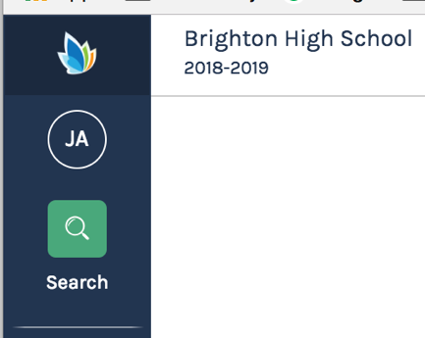

Slide 5
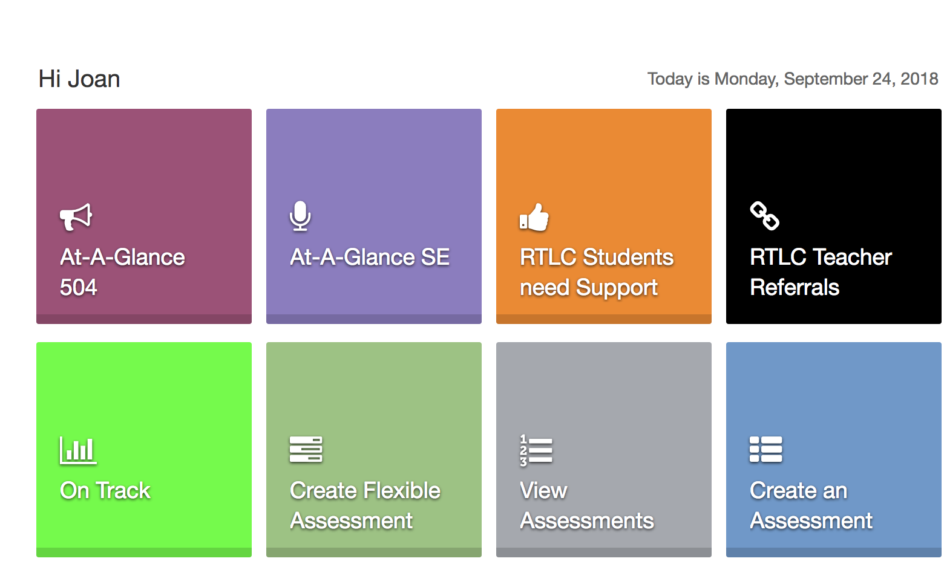

Slide 7
Keep in mind:
You should see the actual plan for details
These are individual and they are meant to help students not dictate actions
Students may have support classes
Some are not updated recently
Something amiss? Let me know

Slide 10
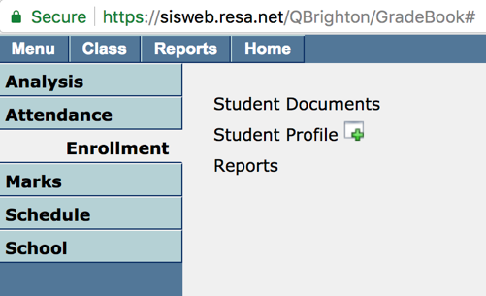
In MISTAR-Q
Click on Menu → Enrollment → Student Documents

Slide 11
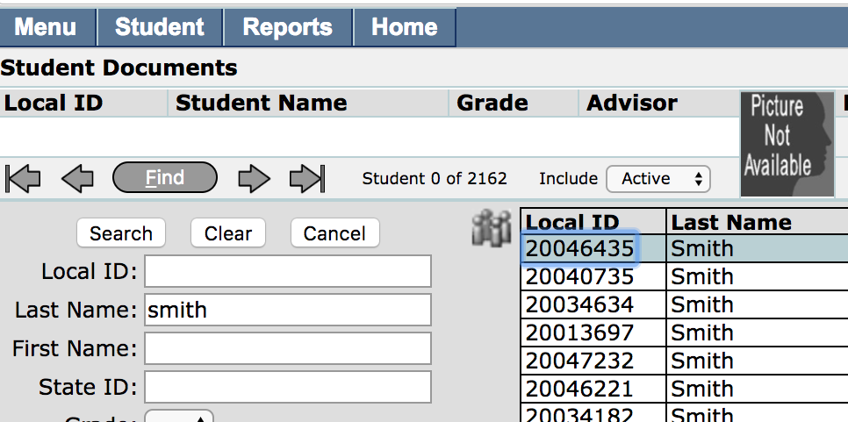
Search for student’s name

Slide 12
Select File called a Notification Letter
– PDF download symbol to the right

Slide 14
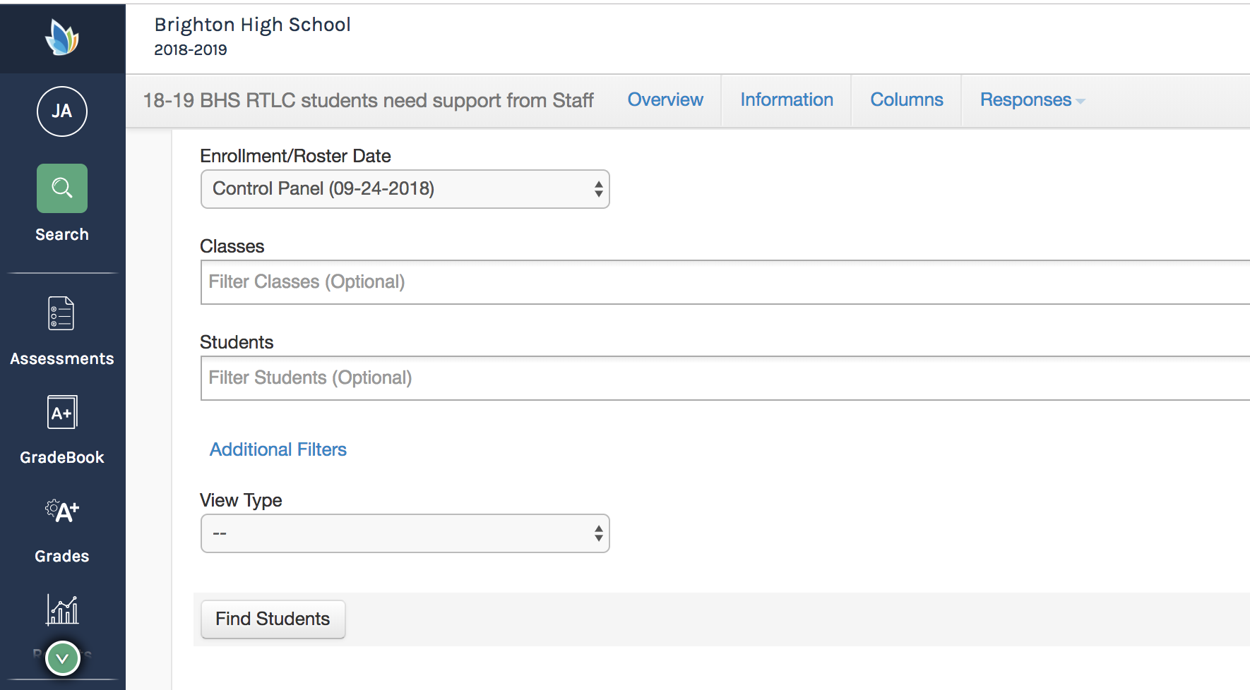

Slide 15
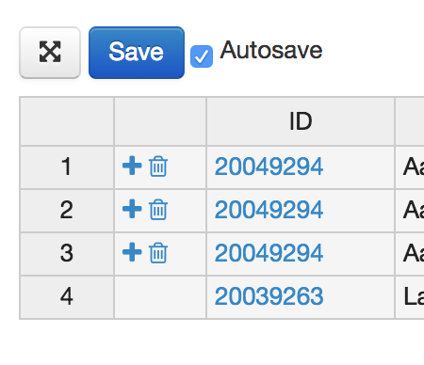
Use ”+” to make a new line if there is already an entry for that student

Slide 16
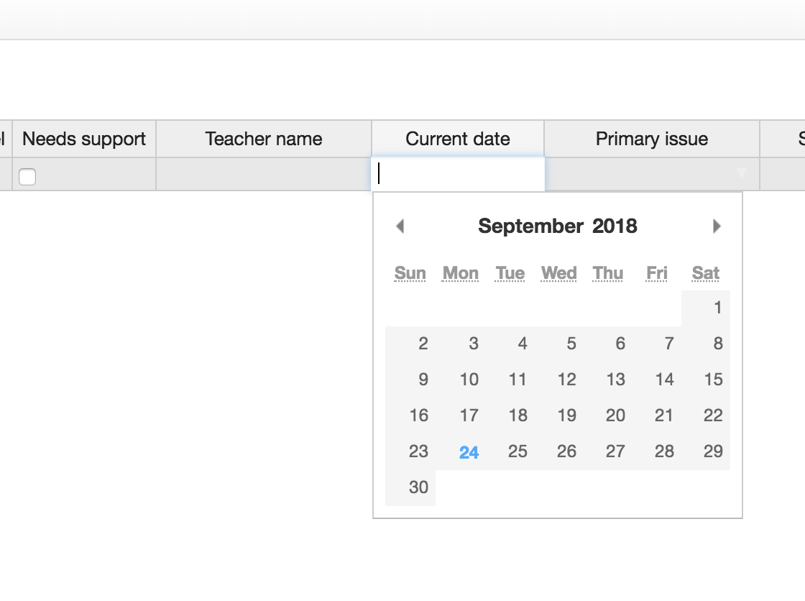
Check needs support
Type in your name
Select date

Slide 17
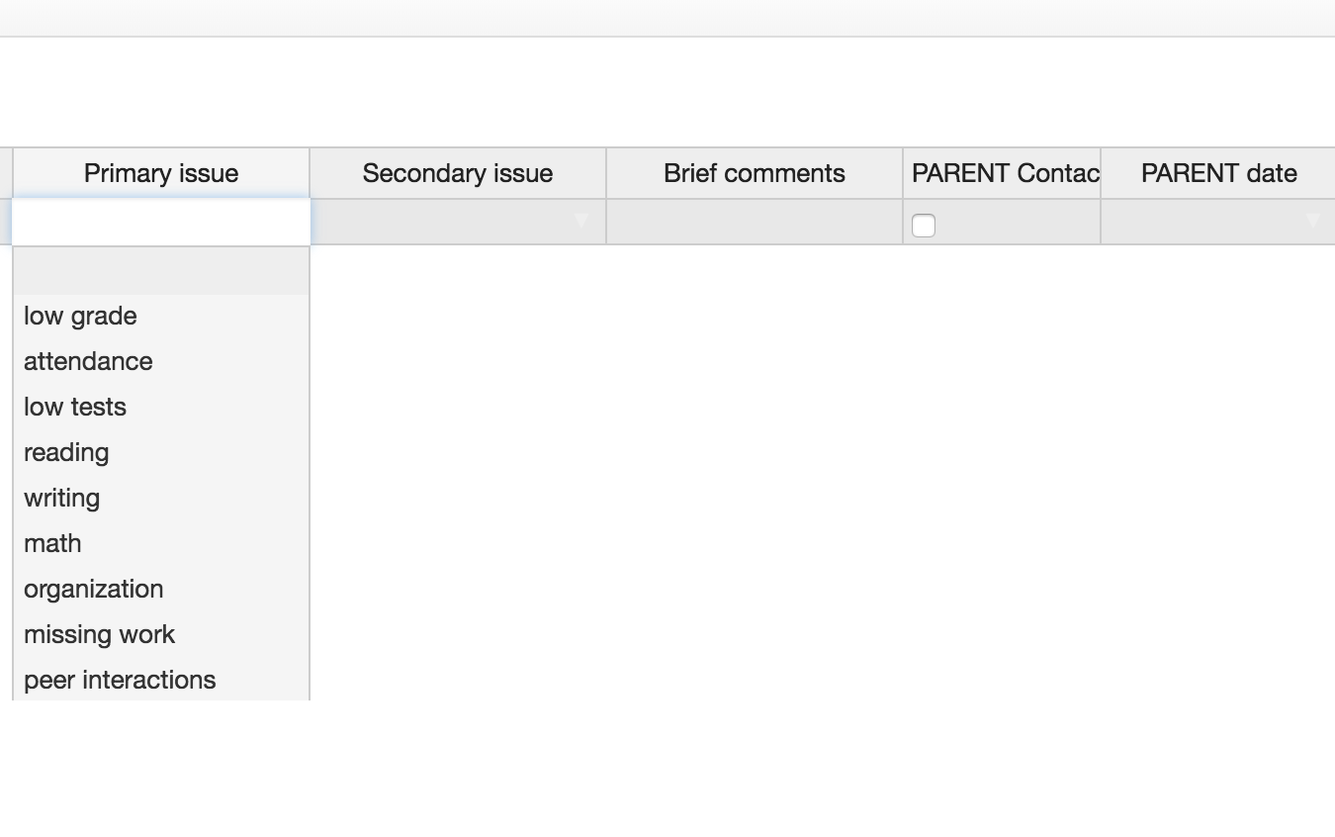
Select primary issue
Rest are optional
Comments are helpful

Slide 19
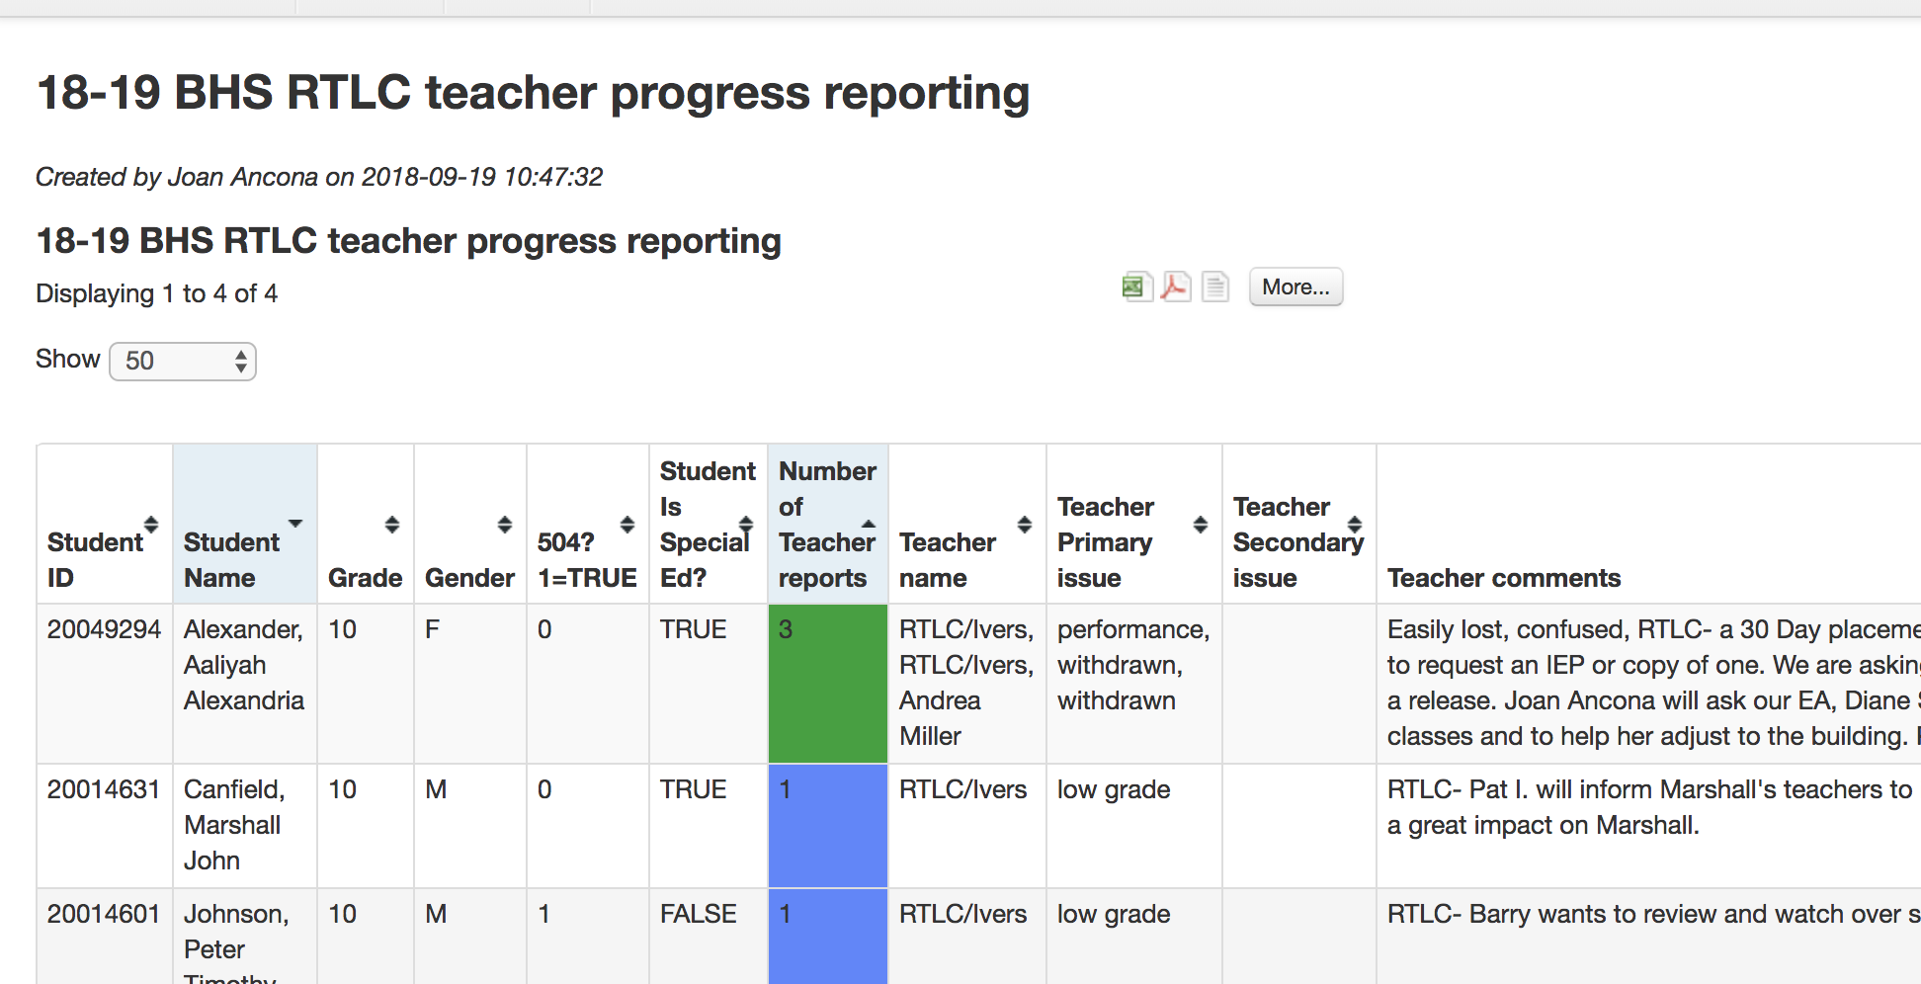

Slide 20
Directions and Pictures
Are on the SI Website
Home Page
Illuminate Page

