Slide 1
PD Monday
March 14, 2016

Slide 2
Pushing grades from Illuminate to MiStar
Yes, you can!!!

Slide 3
1st – create a MiStar task for the score
2nd – scan results into Illuminate

Slide 4
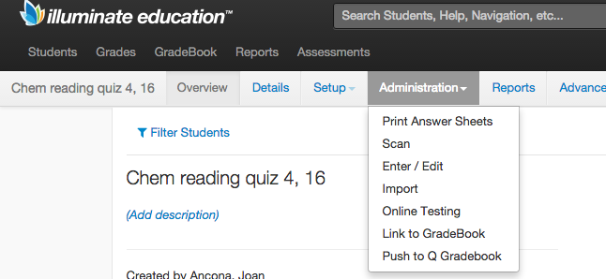

Slide 5
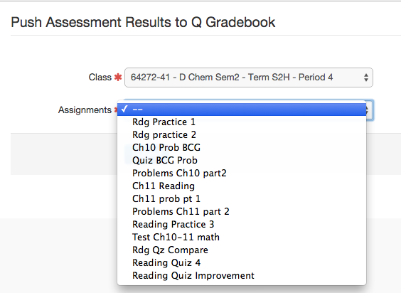
Select
one
class
Choose the MiStar task

Slide 6
CLICK

Slide 7
Thank
Teresa Habsburg

Slide 8
SAT test
Tuesday
April 12, 2016
Tuesday, April 12, 2016

Slide 9
Old vs. New SAT
OLD SAT | NEW SAT
3 hours, 45 minutes (included essay) | 3 hours, plus 50 min essay
Critical Reading | Evidence Based Reading and Writing
Scoring included a penalty for guessing incorrectly | No penalty for guessing – answers only count as positive points
Focus on general reasoning and vocabulary | Focus on research-based College and Career readiness skills
Final “scores” of 600-2400 | Final “scores” of 400-1600

Slide 10
Component | Time Allotted (min) | Number of Questions | Minutes per question
Reading | 65 | 52 | 1.25
Writing & Language | 35 | 44 | 0.80
Essay | 50 | 1 | 50
Math | 80 | 58 | 1.38

Slide 11
SAT Score Reporting
ONE Total Score
400-1600 Scale

Slide 12
SAT Score Reporting…continued
TWO Section Scores of 200-800
Evidence Based Reading & Writing
Math
(The sum of these is the total score)

Slide 13
SAT Score Reporting…continued
TWO Cross Test Scores
– combined from all parts of the SAT test
Earn a 10-40 “point” scaled score in
Analysis in Science
Or
Analysis in History/Social Studies
About 21Q from the 2 related reading passages
About 6Q from 1 related expression of ideas passage
About 7-9Q from math

Slide 14
SAT Score Reporting…continued
Evidence Based Reading & Writing
Has 2 Test Scores – earn 10-40 “points”
Reading
Writing & Language
Has 4 Subscores – earn 1-15 “points”
Words in Context
Command of Evidence
Expression of Ideas
Standard English Conventions

Slide 15
SAT Score Reporting…continued
Math
Has 1 Test Score – earn 10-40 “points”
Math
Has 3 Subscores – earn 1-15 “points”
Heart of Algebra
Passport to Advanced Mathematics
Problem Solving & Data Analysis

Slide 17
Testing Manuals
17

Slide 18
Score Reporting on the SAT Suite of Assessments
Section Scores will be placed on a vertical scale.
Provides consistent feedback across assessments
Indicates if students are making “on target” progress

Slide 19
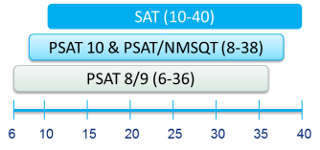
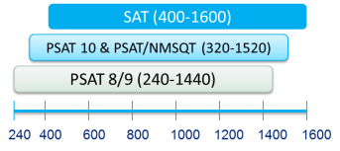
This same concept will hold true for the
Test and Cross-Test Scores as well as Total Score.

Slide 20
Reading Test
5 passages, 1 fiction, 2 science 2 history/social studies
Read passages, interpret informational graphics
Locate information & show understanding of what the author’s words imply

Slide 21
Writing and Language Test
20Q Standard English Conventions, students read the passage, find mistakes & weaknesses and fix them
24Q on “Expression of Ideas” passages, careers, humanities, history/social studies, science

Slide 22
Quick Facts - English
All questions are multiple choice and based on passages
Some passages have tables, charts, and graphs, but no math is required
Prior topic knowledge is never tested

Slide 23
History/Social Studies and Science
Draw on reading skills needed most to succeed in those subjects
Answers are based only on the content stated in or implied by the passage
Interpret data, consider implications

Slide 24
Math Test
Heart of Algebra (19Q), linear equations and systems
Problem Solving and Data Analysis (17Q)
Passport to Advanced Math (16Q), manipulating complex equations
Additional Topics (6Q), geometry and trigonometry

Slide 25
Math Test
58 Total Questions
20Q No Calculator, 25 minutes
5 are grid-in numerical answers
38Q Calculator, 55 minutes
8 are grid-in numerical answers

Slide 26
Quick Facts - Math
Math multiple choice or
Grid-in requiring a numerical answer
Sometimes there are several questions about a single scenario

Slide 27
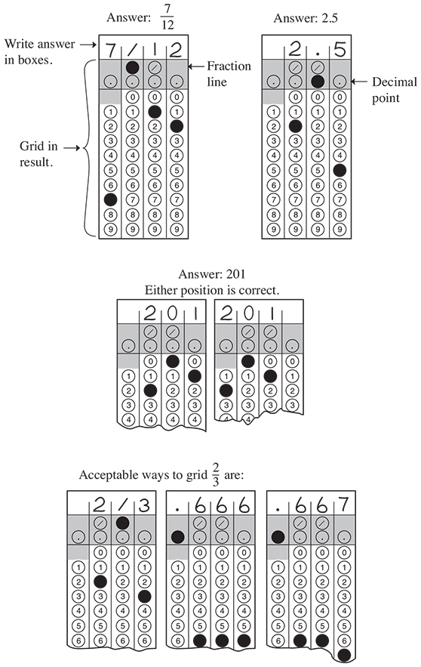

Slide 28
Grid-In
Only the marked circles are graded not the numbers written
Can start anywhere in grid
There are only four total places to write
Can include decimal point
or divided-by line

Slide 29
Grid-In
Can be a decimal or a fraction
Only positive numbers and zero

Slide 30
Grid-In
Do not need to reduce to lowest terms
Mixed numbers must be gridded as improper fractions
If a repeating decimal, must grid most accurate value that will fit

Slide 31
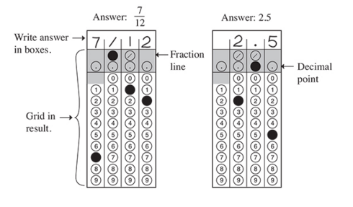

Slide 34
One Essay
Read a passage
Explain how the author builds an argument
Support your explanation with evidence from the passage

Slide 35
The Essay Prompt
Nearly Identical Every Time
As you read the passage below,
consider how [the author] uses evidence, such as facts or examples,
to support claims.

Slide 36
The Essay Prompt, consider:
Evidence – facts or examples
Reasoning – develop ideas, connect claims and evidence
Stylistic or Persuasive elements –
word choice or appeals to emotion to add power to the ideas expressed

Slide 37
Write an essay in which you explain how the author
builds an argument
to persuade the audience

Slide 38
In the essay:
Analyze how the author uses the features listed to strengthen the logic and persuasiveness of the argument
Focus on most relevant features
Do not explain whether you agree or not

Slide 39
In addition to the SAT
ACT WorkKeys – Job Skills Test
M-Step Science, 50 minutes, on-line
M-Step Social Studies, 50 minutes,
on-line

Slide 40
Science and Social Studies
Using current Michigan HSCEs
Until
2019-2020
New Content, Alignment and Questions

Slide 41
Sample
Questions

Slide 42
Today’s
Challenge

Slide 43
Submit your ideas via e-mail to: bhsschoolimprove

