Slide 1
SI – PD, JANUARY 2016

Slide 2
SUMMARY ASSESSMENT

Slide 3
USEFUL FOR ADDING
A SINGLE SCORE or
A GROUP OF SCORES
When each item is not assessed separately

Slide 4
NOTICE HOW ILLUMINATE
SETS UP TABS AND SUB-TABS

Slide 5
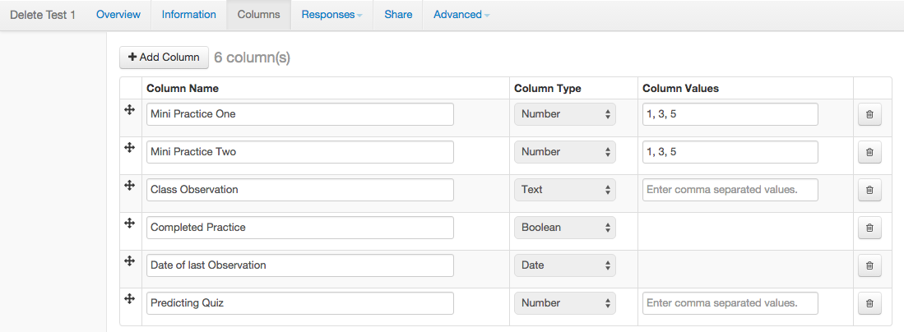
ADD COLUMNS
CREATE A SPREADSHEET

Slide 6
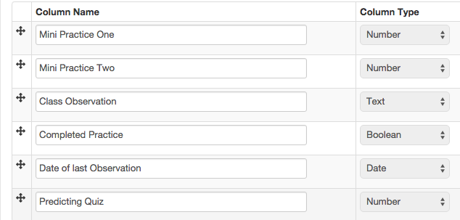
For example:

Slide 7
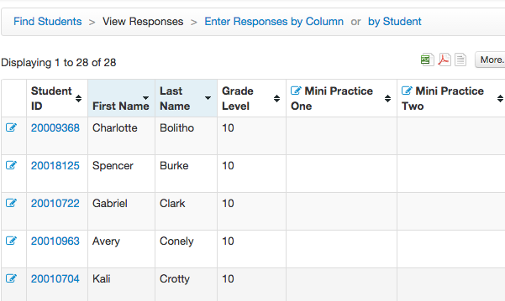
Enter by student or by column

Slide 8
Can import data from excel
Can share assessment with others and they enter their own student data
Can create a report from the data

Slide 9
Quick Demo
Brainstorm
Share Out
Challenge

Slide 10
ITEMBANK ASSESSMENT

Slide 11
USEFUL FOR
CREATING YOUR OWN TESTS
or
FINDING QUESTIONS FOR A NEW TEST
New Assessment
Can be set up for
On-line Administration

Slide 12
You will be taken to a new
Illuminate interface:
You may have to set up a new password (use the same one)
Only need it this once

Slide 13
Choose from 4 options:
Assessment (Standard Mode)
Assessment (Quick Mode)
Item
Passage

Slide 14
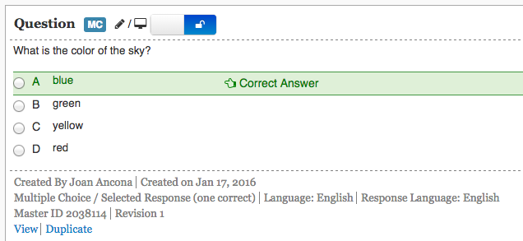
Item or Passage – write your own
Will be added to a data bank
Must know the standard

Slide 15
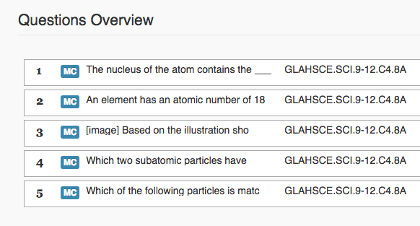
Quick Mode
Know a Standard-Make a test

Slide 16
INSPECT ® ItemBank
All the new SBAC types
MC: Multiple choice
MS: Multiple choice – multiple correct
EBSR: Evidence-based selected response
ST/CR: Short text constructed response
EQ: Equation/Numeric
TI: Fill-in tables
DD: Drag and drop
G: Graphing
GI: Graphing Interaction/Multi-part
MA: Matching tables
HT: Hot text
(listening, technology enabled questions)

Slide 17
Quick Demo
Brainstorm
Share Out
Challenge

Slide 18
STUDENT PORTAL

Slide 19
USEFUL FOR
SHARING TEST RESULTS WITH STUDENTS
ADMINISTERING
ON-LINE TESTING

Slide 20
Manage Portal Access
Set up a temporary password
They change to their own

Slide 21
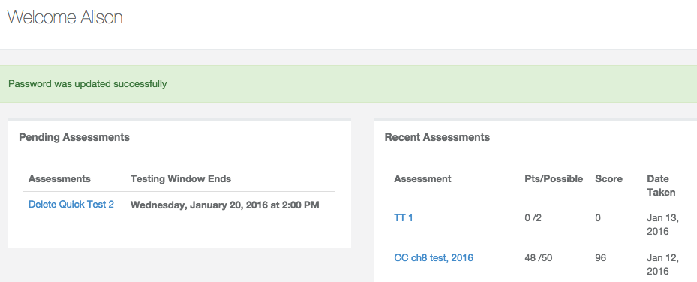
brighton.Illuminatehc.com
User name: Student ID

Slide 22
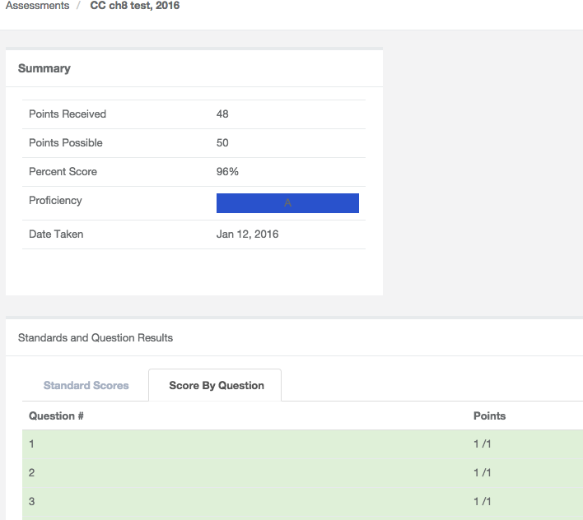
Can see assessment results
ONLY question # & correct/incorrect
Unless you add other permissions

Slide 23
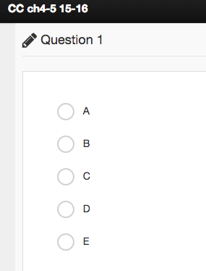
Can set up any test for on-line use
Students will see the question
If you created it in
Illuminate Itembank
Or just bubbles
for paper test

Slide 24
Quick Demo
Brainstorm
Share Out
Challenge

