Slide 1
Accomplishments
2015-2016

Slide 2
BHS Fall 2015
Continuous School Improvement
From Good to Great

Slide 3
PROCESS OVERVIEW
Curriculum Quarterly Data & SI Improve
Standards Exams Discussion PD Student
Eval Achievement

Slide 4
School Improvement Goals
How did we do?

Slide 5
All teachers will work in a PLC to collect and analyze data from CQEs

Slide 6
Teachers will use
Item Analysis
To Determine Trends
And
Identify Areas of Need

Slide 7
Using Illuminate

Slide 8
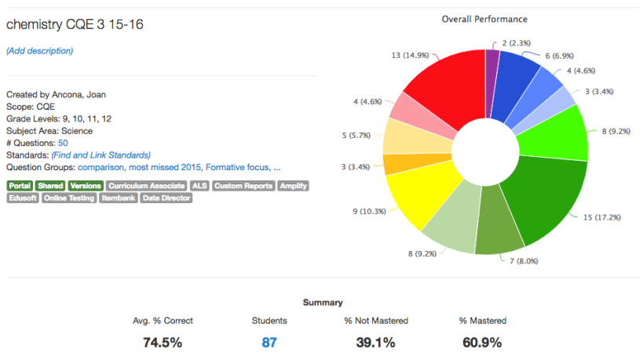
Overview

Slide 9
Student Responses

Slide 10
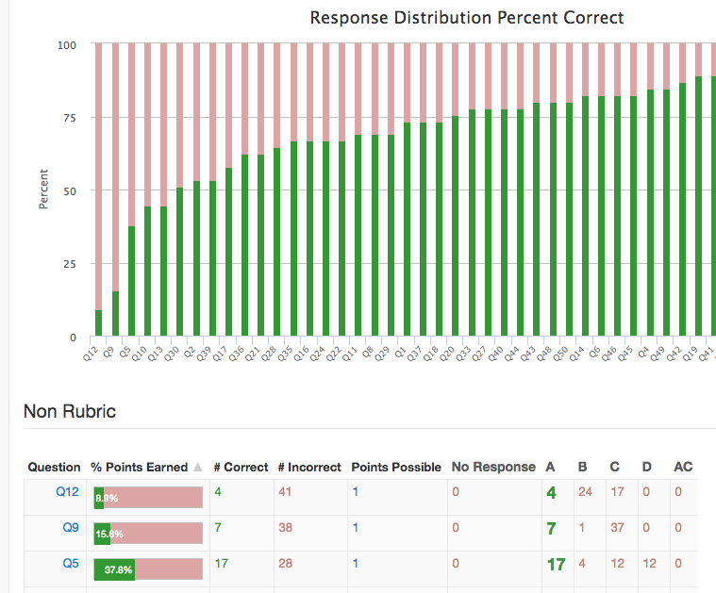
Response Frequency

Slide 11
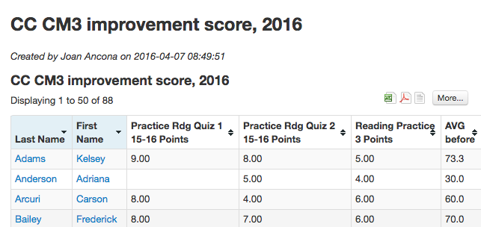
Custom Reports

Slide 12
We did that!

Slide 13
Teachers were trained in . . .

Slide 14
Setting up tests
Scanning results
Linking standards and question groups

Slide 15
Creating Summary Assessments
Creating a test using the Itembank
Accessing the student portal

Slide 16
Made time for learning a new…
Evaluation tool

Slide 17
Closely examined…
New SAT test

Slide 18
Took time for…
Safe Schools Training

Slide 19
What’s next?

Slide 20
Introduction to Backward Design
Move from just “covering curriculum” to “creating curriculum.”

Slide 21
What are the essential concepts that students need to answer?
Identify desired results
Determine acceptable evidence
Informal checks? Quizzes/Tests? Performance Tasks?
What activities will give students the essential knowledge and skills needed to demonstrate achievement as determined at the beginning of this process?
Plan learning experiences and instruction
Notes:
Standards provide a framework that helps us identify teaching and learning priorities.
Magna Carta example – Big idea is the rule of law – limiting govt power, rts of individuals; Magna Carta is just one example
Big ideas may be there every year in new ways – how does rule of law change in American history vs. world history
Rather than creating assessments near the conclusion of a unit or relying on the tests provided by the textbook publishers, backward design asks us to look at various types of assessment evidence before we plan our unit activities. Thinking like an assessor more sharply defines our teaching. IT IS NOT TEACHING TO THE TEST. It is teaching to ensure students understand the key concepts.

Slide 22
Worth being familiar with
Important to know and do
Enduring
Understanding
Notes:
Given that there is typically more content than can reasonably be covered, determining essential concepts (enduring understandings) will help us make good choices.
Worth being familiar with: what do we want students to read, view, research, encounter?
Important to know: student learning is not complete without mastery of these essentials; this is prereq knowledge/skills so students can successfully perform key assessment tasks. These are often the traditional quiz/test type items.
Enduring: students will retain even after they may have forgotten some details from the middle ring

Slide 23
Examining Standards First
Standards provide a framework. We decide from that framework what is worthy of understanding.
The essential concepts and main ideas then suggest the kinds of performances vs. just using assessments as tests based on a textbook.
This helps us decide what knowledge and skills we need to teach.
The text becomes just one resource vs. the text as the syllabus

Slide 24
Why Assessments Next?
Assessments:
provide key targets to focus on when creating or adjusting lesson plans.
tell us what content needs to be covered vs. content that isn’t essential to the key concepts.
help us determine what strategies are most effective in reaching the learning targets.
Notes:
Continuum of assessments
Informal checks for understanding …Observation/dialogue …quiz/test …Academic prompt …Performance task/project
If Q about CQEs – eventually these Qs should reflect enduring understanding vs. “need to know” from the middle ring

Slide 25
A Process, not an Event
Emphasis is on student enduring understanding.
Students can learn skills that continue from year to year.
Backward design takes time – not done in just one year.

