Slide 1
From Good to Great
Continuous
School Improvement
October 19, 2015

Slide 2
Essential Questions

Slide 3
How is the role of the teacher changing as education is changing?

Slide 4
What kinds of classroom strategies lead to students who are actively involved in making learning happen for themselves?

Slide 5
What can teachers do to uncover and change student misconceptions?

Slide 6
What kind of feedback opportunities do we provide our students?

Slide 7
Expectations
Using Illuminate to gather data for CQEs each quarter
Using Illuminate to analyze data from CQEs each quarter
Using Illuminate for student profile information

Slide 8
Support for you
Bhsschoolimprove.weebly.com
SI → Resources
Contact Joan, Colleen, or Jeff
Or a Colleague near you
Wednesday After School
– this week and next, Room C-12

Slide 9
Expectations
Working with Colleagues
Form a PLC (3-5 teachers)
Must be similar in content – backwards design
Choose ONE you will be focusing on for data analysis
Choose one that offers you SUPPORT

Slide 10
Expectations
Linking Standards
and Question Groups
One exam at a time
For data analysis purposes

Slide 11
1st quarter CQE
1) Name it:
Chemistry CQE1A 15-16
2) Be sure it is saved to your department folder

Slide 12
1st quarter CQE
3) One person completes “manual set-up”
4) Share with colleagues
5) Share with BHS principal

Slide 13
Creating multiple versions
Setup Versions →
Add a New Version

Slide 14
Version 2 needs to be matched to the Master
Question 1 = Question 3 on Master
Double Check the answers

Slide 15
Student Answer Sheets will have a place to mark Version
Answer sheets can be scanned in any order – the program will sort the results by version

Slide 16
SCANNING ANSWERS - Choices
MAC –
Use Web Camera on your lap-top
(Document Cam not an option at this time)

Slide 17
SCANNING ANSWERS - Choices
For Document Cam
Download Camera
Software to PC
Plug into “USB”
PC – Use
DocumentCam
Or
Use WebCam
MUST BE IN FIREFOX

Slide 18
SCANNING ANSWERS - Choices
Set up Your E-mail in the copier
Scan exams and send to yourself
Download & save the file to a folder you can find
Everyone can
Use Copier as a
Scanner and
e-mail the file
to yourself.

Slide 19
Administration → Scan → Tools
SCANNING ANSWERS - Choices
Choose Process images from a file
Then choose your file
And Click on Scan Now

Slide 20
LINKING STANDARDS & CREATING QUESTION GROUPS
Label your master test first Use state standards Choose content topics Assign chapter numbers
Assign question types

Slide 21
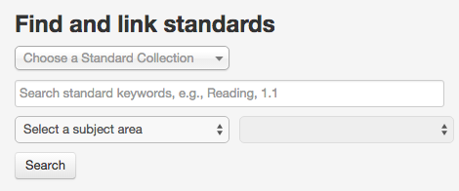
LINKING STANDARDS
Set up → Standards Alignment
Start with subject area,
Scroll down for Grade Level & High School Content Expectations:
Grades 9-12

Slide 22
LINKING STANDARDS
Expand the selection by clicking on the (+) over and over to find a specific standard
Select as many as apply throughout the test
Link selected standards

Slide 23
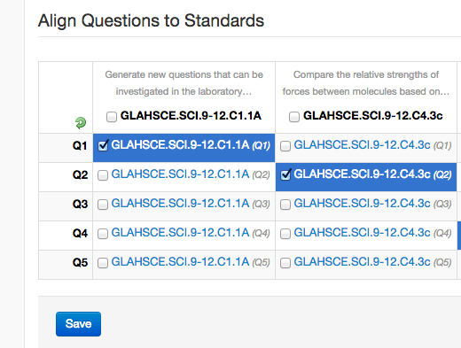
LINKING STANDARDS
Finally, Go to
Set up → Standards Alignment
Select which questions match each standard
Save

Slide 24
QUESTION GROUPS
Go to: Set up → Question Groups
Select: Add Question Groups
List all at once

Slide 25
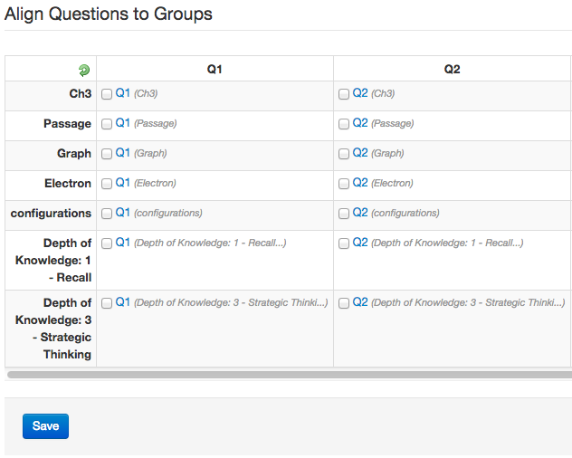
QUESTION GROUPS
Go to: Set up → Question Groups Alignment
Select which belong to each question

Slide 26
Illuminate Support
Be careful transferring student data from Illuminate list to gradebook or MIStar
Apostrophe names may alphabetize differently
Help is available – check out all the directions documents on our website at SI → Resources

Slide 27
Illuminate Support
Illuminate is for raw data –
You cannot directly add points to fashion a curved score
Rescoring is possible without Rescanning
Ask for help if you enter a key answer wrong
or wish to eliminate a question from the test, etc.

Slide 28
Challenge
Set up and share your 1st CM CQE
THIS WEEK
Before our next PD on Monday
Ask Questions – Get help
Share responsibilities

Slide 29
Today
Set up your PLC
Take our Survey
See Web Site – Home Page
Work on 1st CM CQE
– Tweaking or Setting up in Illuminate

