Slide 1
This Powerpoint is available on the SI website
Bhsschoolimprove.weebly.com
Joan Ancona

Slide 2
Welcome back
Bulldogs!
My new role
Illuminate Updates
10 Things you can do with DATA

Slide 3
½ day Illuminate Coach
Provide Data Support
SI Goals
RTI/RTLC
EWS – ID students

Slide 4
Teacher
Support

Slide 5
Coming soon:
Electronic storage of 504 docs
At-a-glance reports for accommodated students
Info on students who need support

Slide 6
Using Data = Education Today

Slide 7
New in
Illuminate, 2018

Slide 8
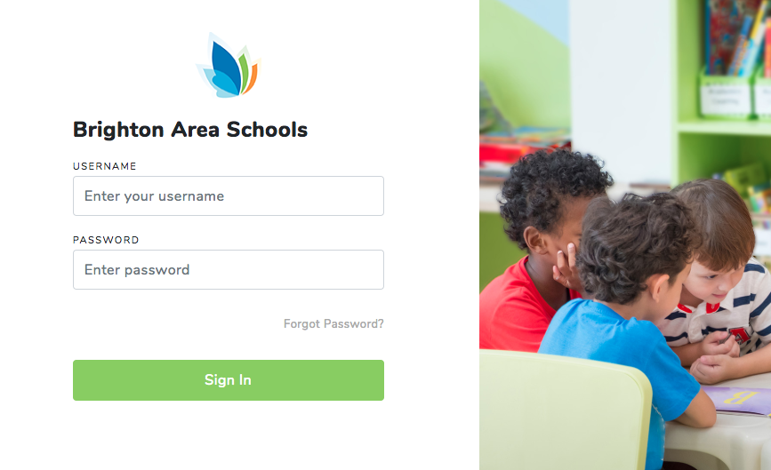
New Homepage…same address

Slide 9
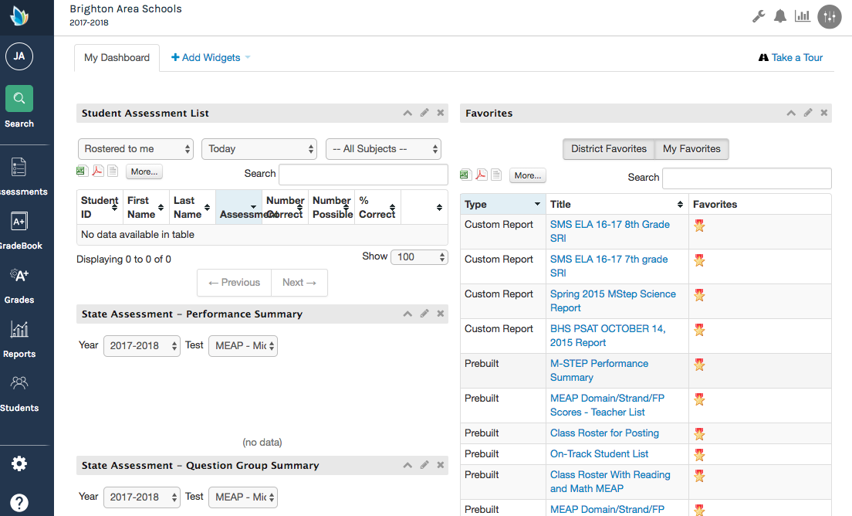
New Landing Page

Slide 10
Navigation Bar to the left

Slide 11
Illuminate Icon for “Tiles”

Slide 12
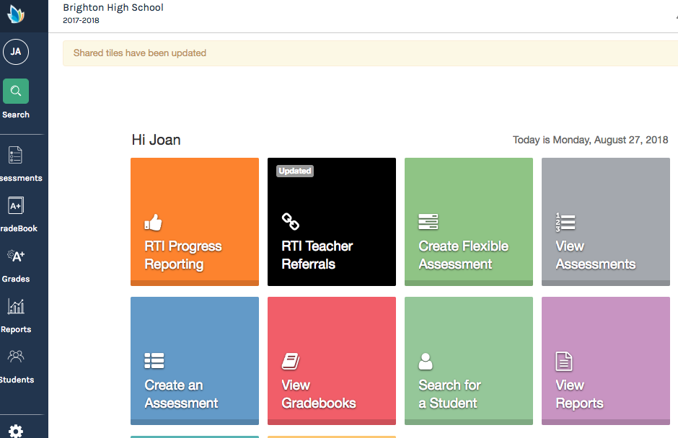
Tiles are shortcuts
like the one we use for reporting students who need support

Slide 13
Click on Your Initials for quick access

Slide 14
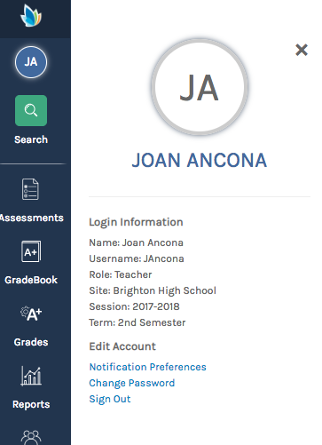
From here:
Sign out
Change Password

Slide 15
Control panel icon upper right

Slide 16
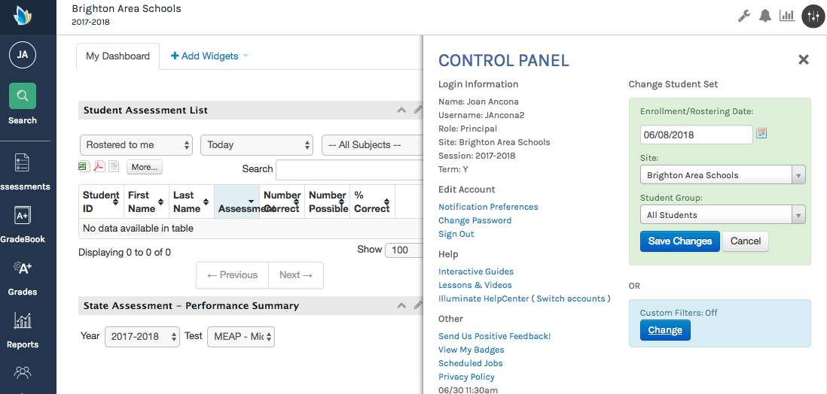
Control panel for sign out

Slide 17
Control panel also for changing dates

Slide 18
Search function

Slide 19
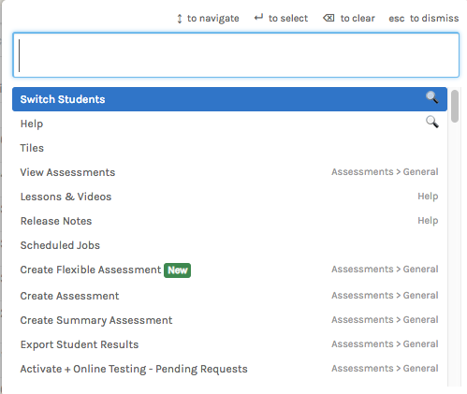
Will help you find
Students by name
Landing pages for tasks

Slide 20
Also toggle to “search” with keystrokes
+

Slide 21
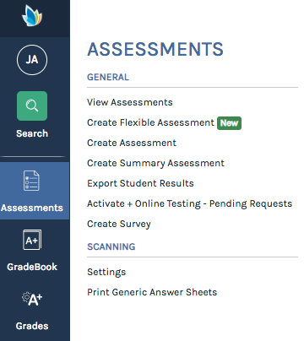
Assessments, View Assessments

Slide 22
Same look, don’t forget you can search using the options to the left

Slide 23
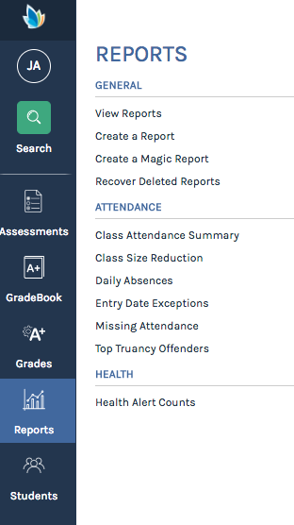
Reports, View Reports

Slide 24
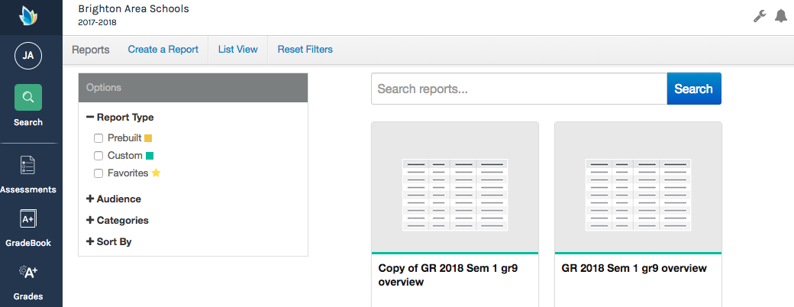
Report view tiles
or choose “List View”

Slide 25
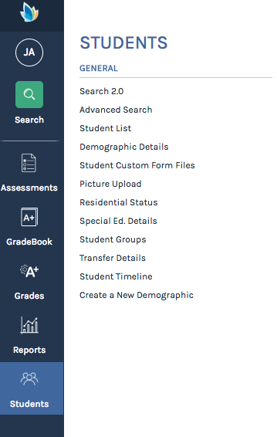
Students, Search 2.0

Slide 27
Any questions?

Slide 28
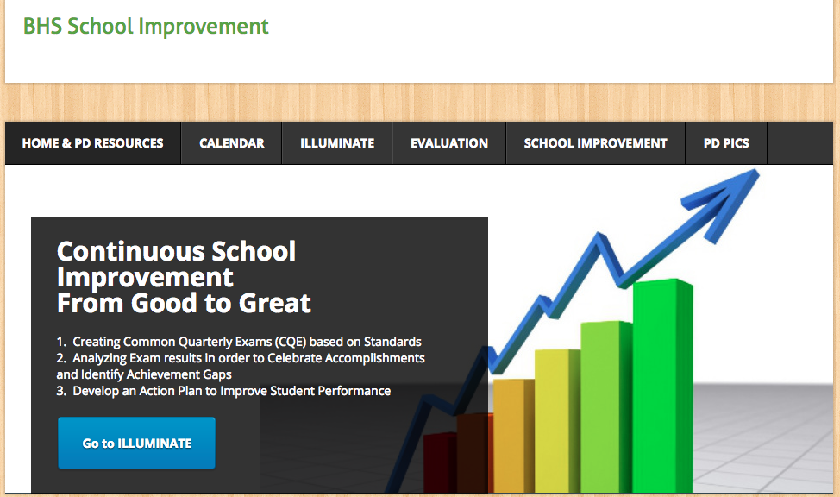
Bhsschoolimprove.weebly.com

Slide 29
Illuminate Resources Page

Slide 30
New Feature:
Flexible Assessments

Slide 31
Assessments,
Create Flexible Assessments

Slide 32
A flexible assessment can be designed to have mixed formats.
Multiple Choice
Essay
Short Answer

Slide 33
A flexible assessment can be checked in a variety of ways.
Scan multiple Choice
Online test auto-checks fill-in
Rubric scoring for essays, projects with expanded values

Slide 34
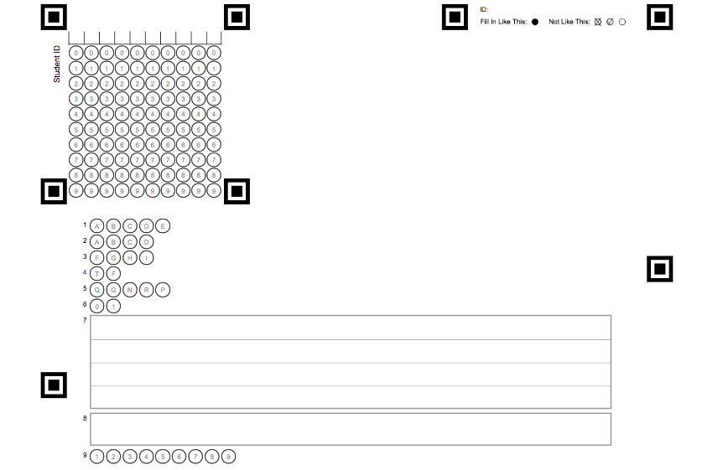

Slide 37
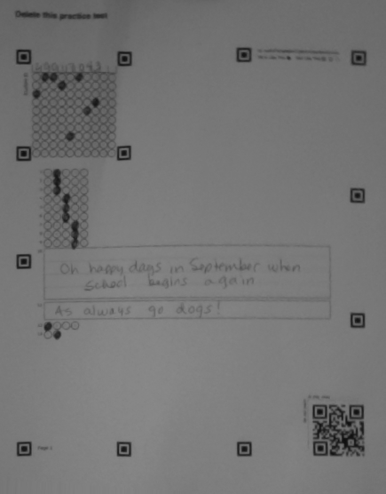
Score by camera/scanner

Slide 38
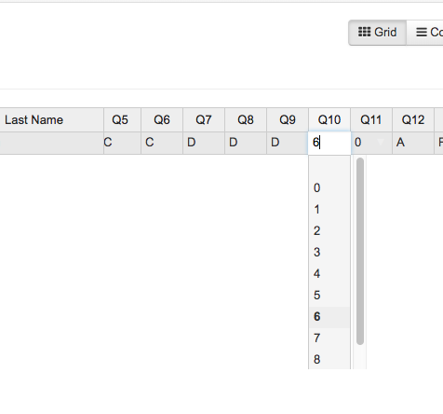
For rubrics, Check by hand from student test paper, enter scores

Slide 39
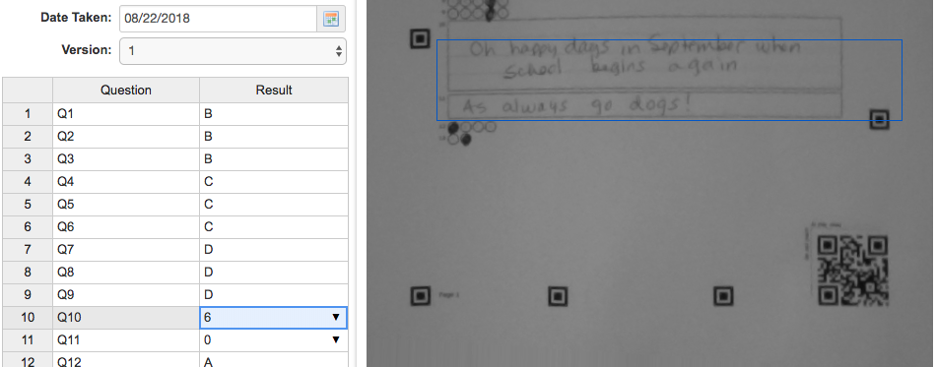
OR Check while viewing on your computer while looking at scan

Slide 40
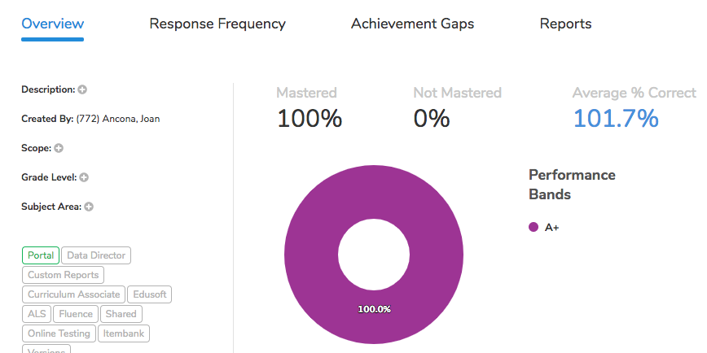
Newer,
Easy-to-use summary page

Slide 41
I can help
Before and After School
Hours 1, 2, 3, 4 in Media Center
SI/Data
Hours 5, 6 in Classroom C-12
anconaj@brightonk12.com

Slide 42
10 Things You can do with

Slide 43
#1
Use data to preview your students:
Transcript
Grades
GPA

Slide 44
#2
Use data to Make a
seating chart
that benefits
students

Slide 45
#3
Look over your CQE data from last year.
Focus on making improvements early in the school year.

Slide 46
#4
Use state testing data to provide appropriate
Reading And
Math Support

Slide 47
#5
Try using an
On-line
Test to generate
Formative data
Use Chromebooks or Take home

Slide 48
#6
Share data with students and get them on-line
so they can get involved in their learning too

Slide 49
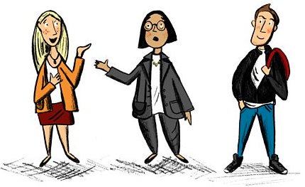
#7
Talk about
curriculum and instruction
using DATA and
Student Information

Slide 50
#8
Find a principal and share some
classroom data

Slide 51
Explore our Data Resources
MiStar-Q
Illuminate
Google Classroom
#9

Slide 52
#10
Ask questions about how to use DATA to improve Instruction
and monitor progress

Slide 53
Thank you!

