Slide 1
Calendar
- Professional Development –
2014-2015, 30 hours
Wed Aug 27 8am-noon (Tech)
Thurs Aug 28 PM 3hrs (CQE)
Mon Sep 15 2:45-4:15pm (CQE)
Mon Sep 22 2:45-4:15pm (CQE)
Mon Oct 13 2:45-4:15pm (CQE)
Mon Oct 20 2:45-4:15pm (CQE)
Tue Nov 4 8am-noon (Tech/CQE)
Mon Dec 8 2:45-4:15pm (CQE)
Mon Jan 12 2:45-4:15pm (CQE)
Mon Jan 19 8am-noon (Tech/CQE)
Mon Feb 9 2:45-4:15pm (CQE)
Mon Mar 9 2:45-4:15pm (CQE)
Mon Apr 20 2:45-4:15pm (CQE)
Mon May 18 2:45-4:15pm (CQE)

Slide 2
BHS Fall 2014
Continuous School Improvement
From Good to Great

Slide 3
School Improvement Plan
Goals, Strategies, and Activities submitted to the state detailing what we want to accomplish
and how it will be done

Slide 4
Program Evaluation Tool
Details one pivotal Strategy we will be using and analyzing over the long term, to accomplish our School Improvement Goals
Common Quarterly Exams
CQE

Slide 5
Continuous Improvement and the Program Evaluation Tool from MDE
Evaluation of strategies to accelerate achievement and close achievement gaps is a key step in the continuous school improvement process.
In addition, all federal programs require annual evaluation.
More importantly, however, is that evaluation represents good practice and will likely improve outcomes.

Slide 6
Research Shows
The work of John Hattie identifies the traits of Expert Teachers – Completed a MetaAnalysis reviewing the evidence of over 800 studies conducted about student learning & achievement
The work of Kim Bailey and Chris Jakicic identifies the traits of Good Assessments

Slide 7
Hattie – Expert Teachers…
Identify the best ways to represent the subjects they teach to maximize student learning
Know more than subject area knowledge
Know the best ways to organize and present information
Continually seek out evidence of those who have not learned and work to continuously improve the classroom experience
Monitor learning
Use formative assessments that gauge content learning
Prompt teacher-to-student feedback & re-teaching as needed
Common unit and quarterly assessments
Data analysis provides feedback to teachers about which lessons were effective and which were not

Slide 8
Hattie – Expert Teachers…
Believe all students can learn
Studies show that those classes with the highest student achievement are those whose teachers are passionate not only about content but also about student achievement
Know there is great power when teachers learn from each other and talk together about planning
Discussing things like learning intentions, success criteria, learning progression, and what it means to be “good at” a subject

Slide 9
Bailey and Jakicic – Good Assessments…
Are common between all teachers of a specific curriculum
Teachers have agreed on the same outcomes
All students are learning the same subject matter even if they have different teachers
Are reliable
Identifiable learning targets address a variety of thinking levels
Provide a sufficient amount of questions to ensure reliable results
All members of the curriculum team agree with the way proficiency has been determined and how the results will be scored

Slide 10
Current Data

Slide 11
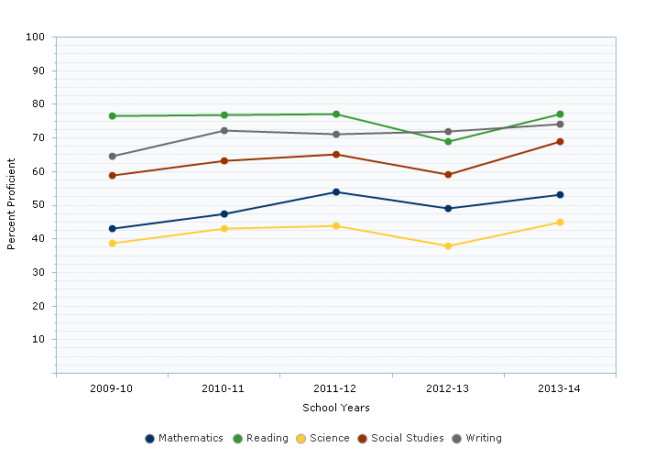
BHS MME TREND DATA – 5 YEARS (all students)

Slide 14
A framework for PD
Curriculum Quarterly Data & SI Improve
Standards Exams Discussion PD Student
Eval Achievement

Slide 15
School Improvement Goal
GENERAL EDUCATION – CORE SUBJECTS
Students at BHS will meet
State Target Proficiency Goals for 2014-2015
In Reading, Writing, Mathematics,
Social Studies, & Science
NOTE: Proficiency Defined as:
Students attain a proficiency performance level of 1 or 2 on the MME test in the given subject area

Slide 16
Target Proficiency Accountability % | READING | WRITING | MATH | SOCIAL STUDIES | SCIENCE
2012-2013 | 77.31 (69.0) | 71.73 (72.0) | 57.11 (49.0) | 67.64 (59.0) | 47.57 (38.0)
2013-2014 | 78.17 (77.1) | 73.21 (74.1) | 60.21 (53.2) | 69.57 (69.5) | 51.73 (45.4)
2014-2015 | 79.02 | 74.68 | 63.31 | 71.50 | 55.89
2015-2016 | 79.88 | 76.16 | 66.41 | 73.43 | 60.05
2016-2017 | 80.73 | 77.63 | 69.51 | 75.36 | 64.21
2017-2018 | 81.58 | 79.10 | 72.60 | 77.28 | 68.36
2018-2019 | 82.44 | 80.58 | 75.70 | 79.21 | 72.52

Slide 17
School Improvement Goal
GENERAL EDUCATION – ELECTIVE SUBJECTS
70% of students in Elective Courses will
Demonstrate Proficiency as measured by their Common Quarterly Exams.
NOTE: Content area expectations apply as identified by the specific area of instruction through the state governing authority

Slide 18
Timeline dates are given for each strategy
General Education Strategies
For Core & Elective Subjects
Strategies don’t have to be completed in a certain order
Multiple strategies can be worked on simultaneously
Each PLC is in a unique starting point

Slide 19
Strategy 1 – General Education
By September 15, 2014
Complete “Basic Checklist” Items
Submit Completed Checklist Individually

Slide 20
Strategy 2 – General Education
By October 20, 2014
Create Testing Parameters to use before, during, and after administration of Common Quarterly Exams
that ensure testing fidelity
Share Testing Parameters with department members, goal is for department to come to consensus
Submit Testing Parameters by Department

Slide 21
Strategy 3 – General Education
1st CM Exams completed by October 13, 2014
2nd CM Exams completed by January 12, 2015
Item Identification on 5 or more items for each CQE by March 9, 2015
Create Common Quarterly Exams (CQE) related to
Content Area Standards and MME Testing Objectives
as appropriate by subject area
Identify test items by Standard or MME Objective
Submit exams by Course

Slide 22
Strategy 4 – General Education
By May 18, 2015
Complete item analysis method and analysis on 5 or more identified items on 1 or more exams given this school year
Develop an Item Analysis Data Collection Method to use on the Common Quarterly Exam
Execute Item Analysis Method
Analyze, graph, and interpret data to identify
areas of accomplishment and achievement gaps
Submit Item Analysis Information by Course

Slide 23
Strategy – General Education
Looking forward to the 2015-2016 school year
Analyze and Improve CQE with Backwards Design using Standards and MME Requirements
Develop PLC Action Plan to improve student performance based on test item analysis
Write a SMART goal
(specific, measurable, attainable, rewarding, timely)
Submit SMART goal and Action Plan by PLC

Slide 24
School Improvement Goal
SPECIAL EDUCATION
SE students at BHS will show improvement in MME Proficiency levels in reading and math

Slide 25
Target Proficiency Accountability % | READING (Students with disabilities) | MATH (Students with disabilities)
2012-2013 | 77.31 (46.0) | 57.11 (<10.0)
2013-2014 | 78.17 (50.0) | 60.21 (11.0)
2014-2015 | 79.02 | 63.31
2015-2016 | 79.88 | 66.41
2016-2017 | 80.73 | 69.51
2017-2018 | 81.58 | 72.60
2018-2019 | 82.44 | 75.70

Slide 26
Strategy 1 – Special Education
1st quarter CQE by October 20, 2014 2nd quarter CQE by January 19, 2015 3rd quarter CQE by March 9, 2015
4th quarter CQE by May 18, 2015
Differentiate Common Quarterly Exams
in mathematics & reading, adjusting the exams to accommodate the specific needs of
students with disabilities
Work with General Education - CORE teachers to provide the most appropriate testing questions and accommodations
Submit Differentiated CQEs

Slide 27
Strategy 2 – Special Education
Ongoing
Develop and implement individualized or small group learning strategies for Mathematics & Reading to support the learning of SE students in their GE classes
Use 25% of daily Resource Room time to work with students using the Math & Reading learning strategies developed
Submit Strategies - Journal Implementation

Slide 28
Program Evaluation Tool - Reporting
READINESS
Understand need
Articulate research
Shared Vision & Purpose
Administrator Commitment
Identify & Address Concerns
KNOWLEDGE & SKILLS
Describe how practices will change
Articulate outcomes
Specify criteria for evaluation
Administrators monitor and assess compliance
Identify & Address Professional learning needs

Slide 29
Program Evaluation Tool - Reporting
OPPORTUNITY
Sufficient Funds
Adequate Resources
Time for staff collaboration
Administrators support teacher needs
Identify & Address Support needed
IMPLEMENT WITH FIDELITY
Define Non-negotiable elements and acceptable variations
Responsibility lists & Timelines
Administrators address unintended consequences
Identify & Address Modifications needed based on data

Slide 30
Survey Results – percent “Yes”
Michigan Merit Exam
Common Quarterly Exams
Understandings
71% Aware of major test parts
66% Aware of how a student is rated proficient
86% CQE needs to be common
69% CQE is related to School Improvement Goals

Slide 31
Survey Results – percent “Yes”
Curriculum
Content
Standards
85% Aware of and understand my course standards
80% Have access to a written copy of my standards
71% Used standards in writing CQE
70% Use standards in planning lessons and writing course assessments
50% Linked standards to specific CQE questions
39% Aware of which standard is tested by which question on the CQE

Slide 32
Survey Results – percent “Yes”
PLC
Work
On
CQE
79% Discussed Common Evaluation
74% Agreed on Common Evaluation
68% Discussed Common Administration
68% Agreed on Common Administration
59% Discussed Common Review
54% Agreed on Common Review
35% Discussed Data Collection
34% Agreed on Data Collection
29% Discussed Data Collected

Slide 33
Action Steps – Semester One
Obtain “Basic Checklist” Complete Requirements: Set up PLC, Identify standards list, Assess current needs, Determine PLC timeline 1st Sem
Prepare 1st CM CQE
Prepare to Administer CQE (before, during, after)
Prepare 2nd CM CQE
Adjust CQE as needed working through “Backward Design” principles

